Slide 1
Understanding Gen-Z Career & Mission Aspirations
Insights for Recruitment, HR & Employer Strategy
Presented by : Sehajpreet Kaur

Slide 2
Project Overview
Objective: To understand Gen-Z career preferences, motivations, and expectations from employers and workplace environments.
Key Stakeholders:
Head of Recruitment
Head of HR
Employers
Focus Areas:
Manager Aspirations
Mission Aspirations

Slide 3
Project Flow
1
Introduction to Problem Statement
2
Data Collection via Google Forms
3
Data Cleaning and Standardization using Excel
4
Exploratory Data Analysis Using Excel Pivot Tables
5
Exploratory Data Analysis Using SQL queries
6
Visualization using Excel Dashboard
7.
Visualization using Power BI Dashboards

Slide 4
Methodology Used
Tools and Techniques:
SQL: Cleaned and structured the raw dataset, used grouping and conditional logic to explore trends.
Excel: Used pivot tables to identify patterns by gender, salary expectations, and career influencers.
Power BI: Designed focused dashboards for manager and mission aspirations using KPIs and interactive charts.

Slide 5
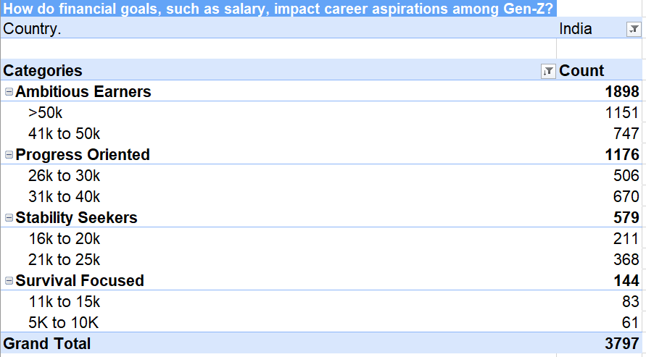
Excel Pivot Table Insights
Half of Gen-Z (50%) are Ambitious Earners, aiming for salaries above ₹41k, showing high financial expectations.
31% are Progress Oriented, targeting steady salary growth between ₹26k–₹40k.
Only 3.8% are Survival Focused, indicating that Gen-Z is driven more by growth than by basic income needs.

Slide 6
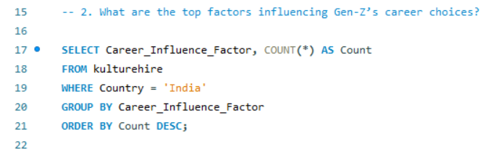
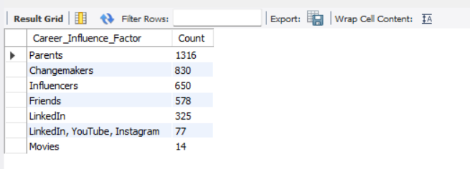
SQL Analysis
Top Factors Influencing Gen-Z Career Choices

Slide 7
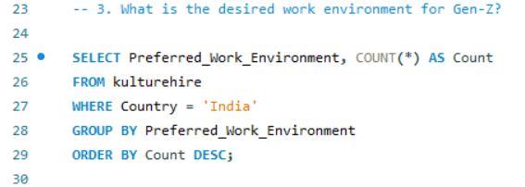
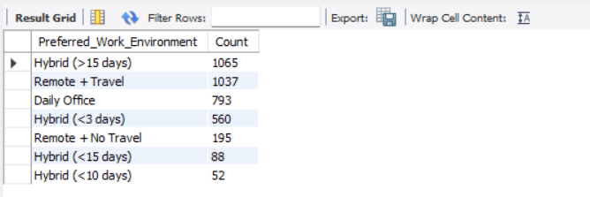
SQL Analysis
Desired work environment for Gen-Z

Slide 8
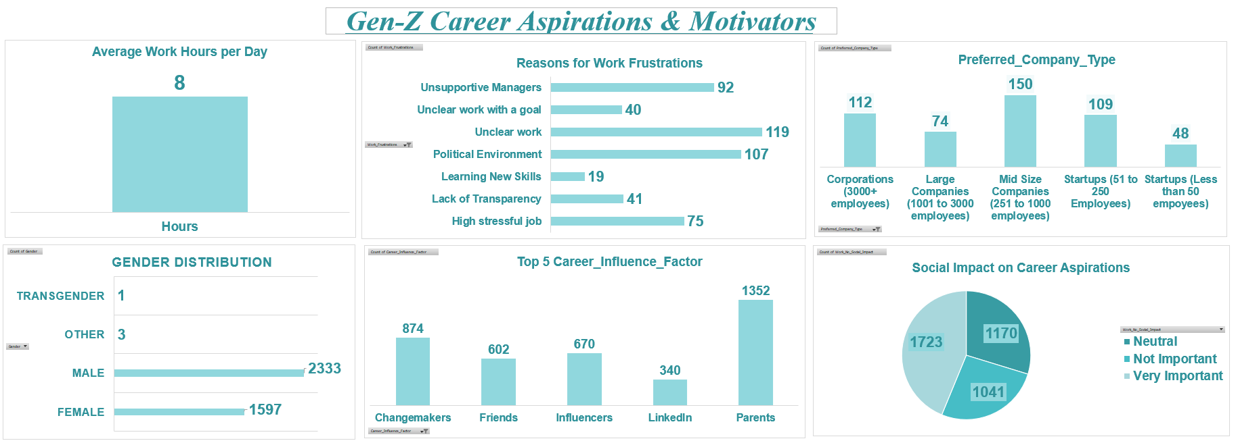
Exploratory Data Analysis Using Excel

Slide 9
Exploratory Data Analysis Using Excel- Insights
Gen-Z prefers balanced work schedules, with an average of 8 working hours per day.
Unclear work and unsupportive managers are top frustrations, highlighting the need for clarity and strong leadership.
Mid-size companies are the most preferred workplace type, indicating a desire for both structure and flexibility.
Parents and changemakers are the biggest career influencers, showing Gen-Z values personal guidance over platforms like LinkedIn.
A significant portion of Gen-Z considers social impact “very important”, suggesting a strong inclination toward purpose-driven careers.

Slide 10
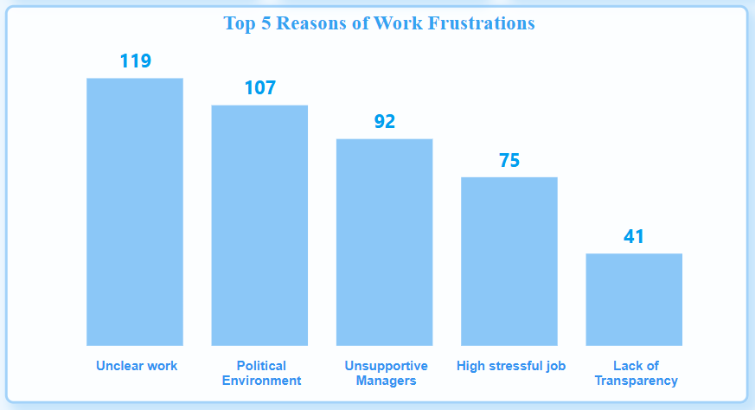
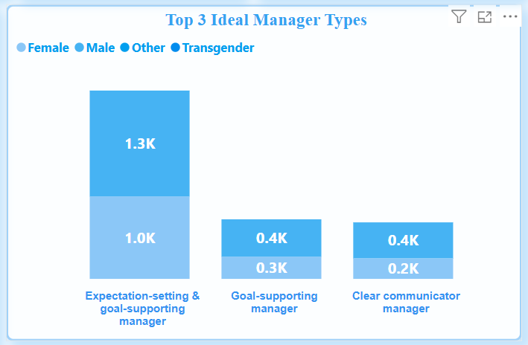
Manager Aspirations

Slide 11
Manager Aspirations - Insights
Key Insights:
Gen-Z prefers managers who are supportive, empathetic, and growth-oriented.
Unclear Work and Political environment are major frustration points.
Frequent breaks and flexible work hours are critical to productivity.

Slide 12
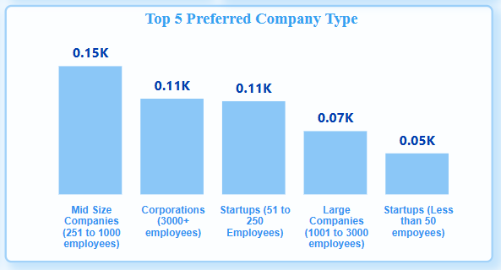
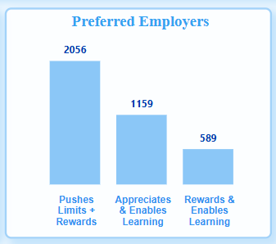
Mission Aspirations

Slide 13
Mission Aspirations – Insights
Key Insights:
A significant portion of Gen-Z avoids roles lacking social contribution or clarity of mission.
Mid-size and Corporations are Gen-Z’s Preferred Company types.
Rewards and Appreciations boosts productivity and improve engagement.
High alignment between values and job roles increases engagement.
Purpose-led companies attract more commitment from Gen-Z professionals.

Slide 14
Recommendations for Employers and HR
Foster transparent and supportive leadership through training and feedback systems.
Redesign job roles to offer clarity, autonomy, and alignment with purpose.
Provide non-monetary benefits such as flexibility, mental health support, and learning opportunities.
Encourage manager-employee engagement through regular check-ins and recognition.
Emphasize value-driven company culture to attract and retain socially conscious Gen-Z talent.

Slide 15
Final Thoughts
Gen-Z desires careers that offer more than a paycheck — they seek purpose, flexibility, and meaning.
Their preferences are shaped strongly by family, influencers, and societal impact.
Leadership and communication quality are central to Gen-Z’s job satisfaction.
Purpose-led roles and socially responsible employers attract long-term commitment.
Leveraging these insights can significantly improve recruitment, retention, and workplace satisfaction.

Slide 16


